Slide 1


Exchange Skills, Grow Together
PROJECT
PROPOSAL
Neighborhood Skill Exchange
Team: Stack_Overflowed

Slide 2

PROBLEM STATEMENT
Many people have valuable skills they are willing to share, while others are eager to learn. However, finding the right person within the local community is often difficult.
~ No dedicated platform for local skill exchange.
~ Difficulty finding nearby people with specific skills.
~ Existing platforms mainly focus on paid services or online courses.
~ Limited opportunities for community-based learning and collaboration.

Slide 3

PROPOSED SOLUTION
To address these challenges, we propose a community-based web application that connects people who want to teach and learn skills within their local area.
~ Create a user account and build a personal profile
~ Add skills and search for skills offered by mentors
~ Send skill exchange request and complete skill exchange sessions
~ Leave ratings and reviews which build trust through user feedback
~ Encourage lifelong learning and community collaboration
~ Make skill sharing simple, accessible and collaborative

Slide 4


TARGETS & OBJECTIVES
Develop a web-based platform that enables people to teach, learn, and exchange skills within their local community.
Community Learning
User Management
~ Connect learners and mentors.
~ Encourage knowledge sharing.
~ Build a collaborative community
~ Secure registration and login.
~ Create and manage user profiles.
~ Ensure user authentication.

Slide 5


TARGETS & OBJECTIVES
Develop a web-based platform that enables people to teach, learn, and exchange skills within their local community.
Skill Exchange
Trust & Growth
~ Add and manage skills.
~ Search for available skills.
~ Send and manage exchange requests.
~ Ratings and reviews.
~ Improve user credibility.
~ Encourage continuous learning.

Slide 6

FEATURES
User Management
Skill Exchange
~ User Registration
~ Secure Login
~ Profile Management
~ Add & Manage Skills
~ Search Skills
~ Exchange Requests
Store System
Community & Trust
~ Buy Learning Resources
~ Sell Study Materials
~ Manage Products
~ Ratings & Reviews
~ Notifications
~ Exchange History

Slide 7
TECHNOLOGY STACK
Layer | Technology
Frontend | HTML, CSS, JavaScript, Bootstrap
Backend | Flask (Python)
Database | MySQL
Version control | Git & GitHub
Containerization | Docker

Slide 8
PLANNING & DESIGN
PROJECT TIMELINE
• Project proposal & requirement analysis
• Literature review & market research
• UI/UX wireframe design
• Database (ER Diagram) & system planning
JULY
DEVELOPMENT & INTEGRATION
• Frontend development (HTML, CSS, Javascript, Bootstarp)
• Backend development (Python, Flask)
• Database integration (MySQL)
• Implement core features (Login, Skill Exchange, Store System)
AUG - SEP

Slide 9
OCT
TESTING & REPORTING
PROJECT TIMELINE
• Testing & bug fixing
• Docker setup & GitHub documentation
• Final UI improvements
• Project report, presentation & final submission
LAUNCHING

Slide 10




EXPECTED OUTCOME
Easy Skill Exchange
Community Growth
Find local learners and mentors.
Exchange skills efficiently.
Improve accessibility.
Encourage collaboration.
Share knowledge locally.
Strengthen community connections.
User Satisfaction
Future Ready
Simple and intuitive interface.
Secure authentication.
Reliable rating system.
Scalable architecture.
Store system integration.
Support for future enhancements.

Slide 11


FUTURE PLAN & VISION
Future Plan
Vision
Launch a mobile application (Android & iOS).
Integrate AI-based skill recommendations.
Add real-time video learning.
Expand the marketplace with secure online payments.
Build the largest community-driven skill-sharing platform.
Connect learners and mentors across the country.
Promote lifelong learning and knowledge sharing.
Empower individuals through accessible education and collaboration.

Slide 12

BENCHMARK ANALYSIS
Feature |  | MentorHub | Udemy | Superprof
Free Teaching Option | ✅ | ✅ | ✅ | ✅
Paid Teaching Option | ✅ | ✅ | ✅ | ✅
Nearby Mentor Search | ✅ | ❌ | ❌ | Limited
Skill Exchange Between User | ✅ | ❌ | ❌ | ❌
Document Verification | ✅ | ✅ | ❌ | ✅
In-App-Chat | ✅ | ✅ | ❌ | ✅
Rating & Review | ✅ | ✅ | ✅ | ✅
Learning Equipment Store | ✅ | ❌ | ❌ | ❌
Community Based Learning | ✅ | ❌ | ❌ | ❌

Slide 13
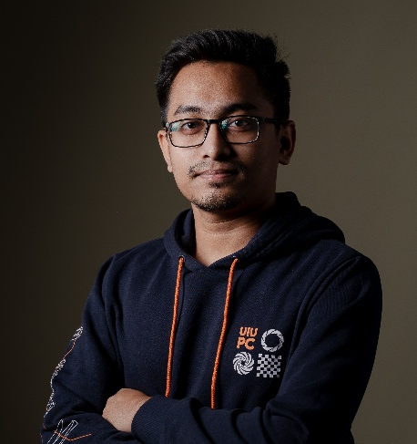
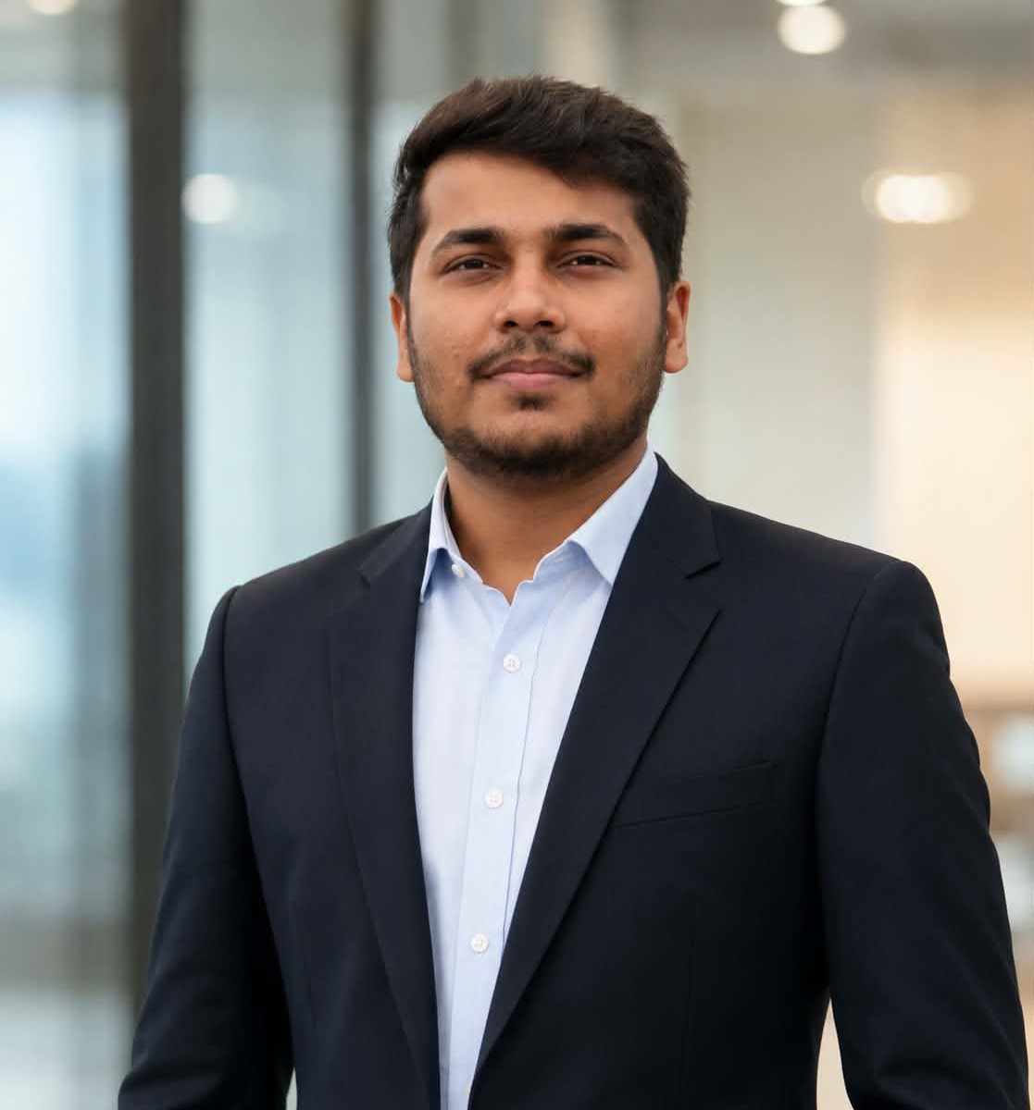
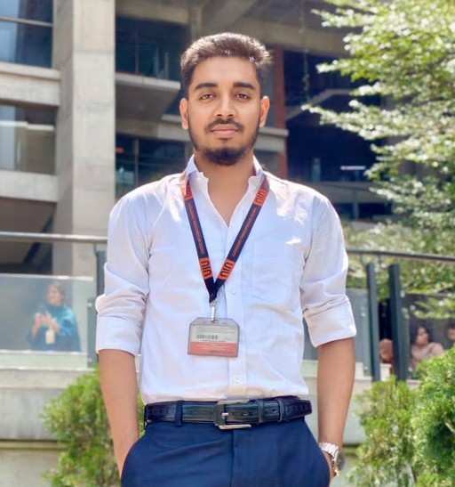
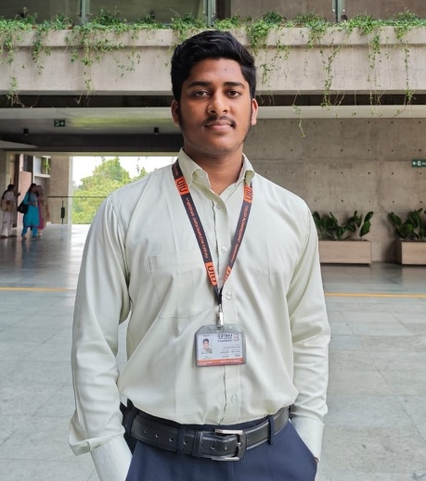
THE MINDS BEHIND
Pratoy Barua
Waled Rahman
Asifur Rahman
MD Rejwan
Backend
Frontend
Database
Backend
BACKEND
FRONTEND
DATABASE
DOCUMENTATION

Slide 14
THANK YOU

